Slide 1
Applied Machine Learning - Group Project CREDIT CARD DEFAULTER CLASSIFICATION
Group-11
Abhiram Karumanchi
Haritha Chilakala
Sai Praneetha Pathakamuri
Sindhuri Bonam
Vicki Song

Slide 2

INTRODUCTION
Credit card default happens when you have become severely delinquent on your credit card payments.
Default is a serious credit card status that affects not only your standing with that credit card issuer but also your credit standing in general and your ability to get approved for other credit-based services
The question every bank has – Will the client be able to make the credit card payment?
Credit card firms can gain tremendously by focusing on the consumers identified by the model as being most likely to default on the next month's payment. As a result, resource management is improved, and profits are increased.

Slide 3
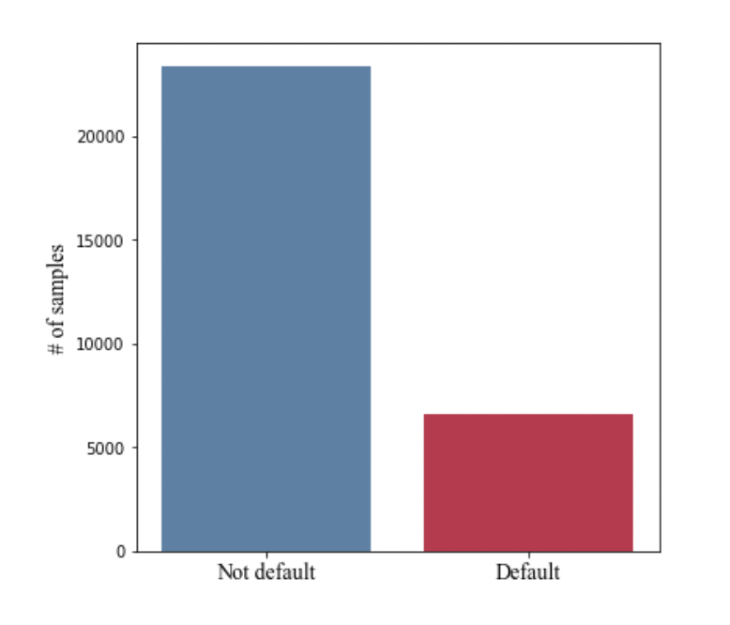
PROJECT OVERVIEW - part1
Problem Statement:
To build a classifier model that can predict whether a consumer will miss their next credit card payment.
To use multiple classification techniques in this process and compare metrics across the techniques and come out with the best model that can classify the customers with highest accuracy.
To understand the factors which are highly effective in the default of the payments by the customer.
It is a binary classification problem on a relatively unbalanced dataset, as shown in the following figure.

Slide 4
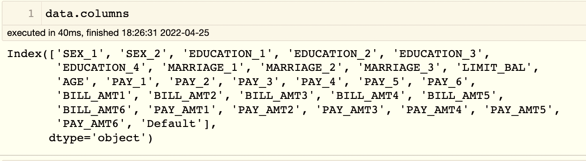
PROJECT OVERVIEW – part2
Data source: https://archive.ics.uci.edu/ml/datasets/default+of+credit+card+clients#
Data Set Description:
The data has 30000 observations and 25 fields
The Response (Output variable) is a binary variable ‘default payment next month’
Each observation is the data of an individual user – Education, Sex, Age, Bill amounts for past 9 months, payment details for past 9 months etc;

Slide 5
METHODOLOGY
1
Data Exploration
2
Data Pre-processing
3
Model Selection
4
Model Comparison
5
Model Evaluation

Slide 6
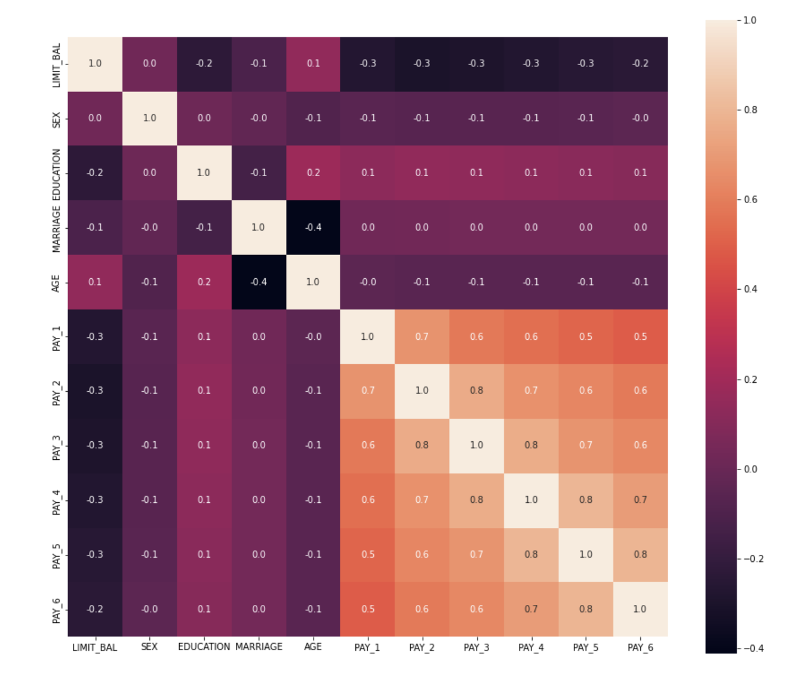
DATA EXPLORATION - part 1
Missing Data and Data cleaning
The data set is clean without any missing data.
For attributes – MARRIAGE, EDUCATION, there are some undocumented categories. Dropped such rows.
Feature analysis:
Each observation has 25 attributes that contain information on default payments, demographic factors, credit data, history of payment and bill statements of credit card users.
Correlation: Heatmap
The presence of strongly correlated features may lead to a decline in the performances of some classification algorithms which assume that the predictors are all independent.
Another benefit from spotting correlation among features is that the same information may be encoded with less attributes, and this could lead to simpler final models.

Slide 7
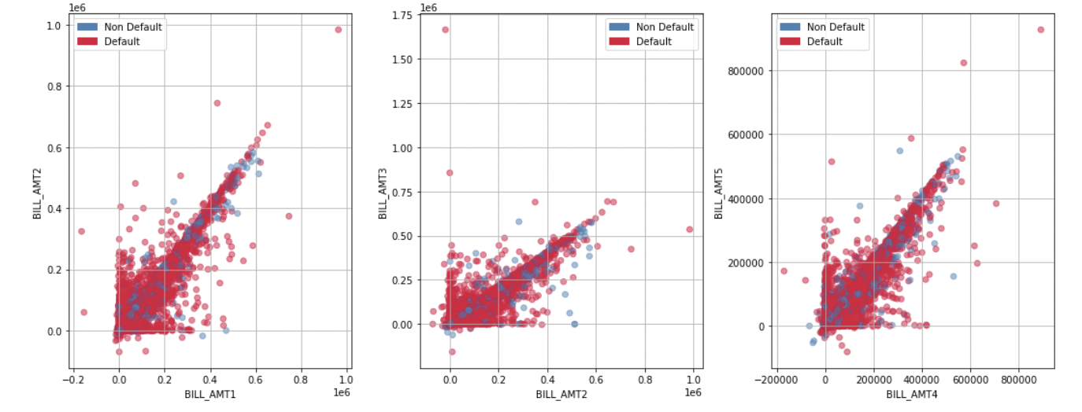
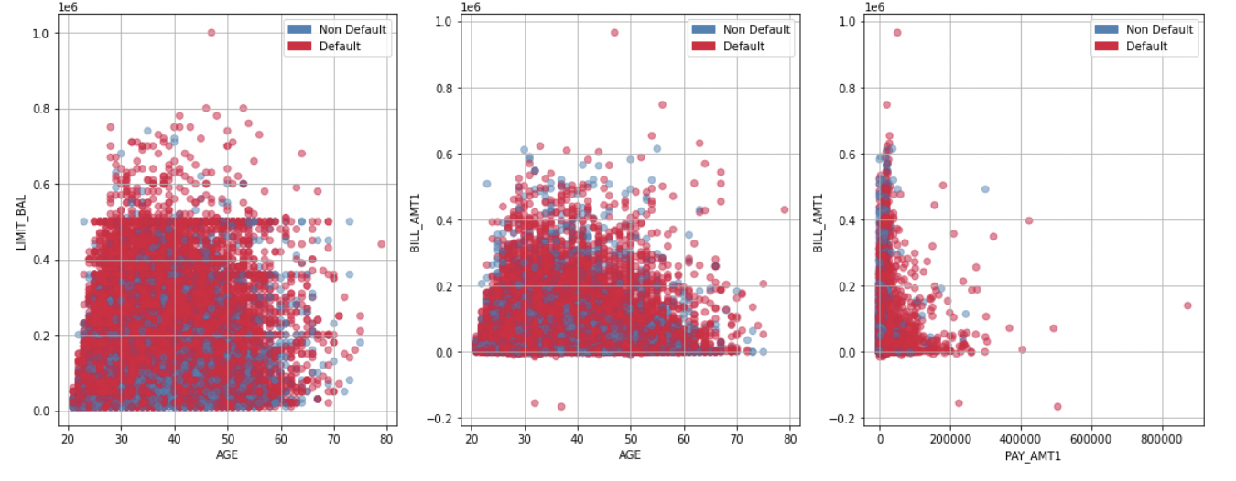
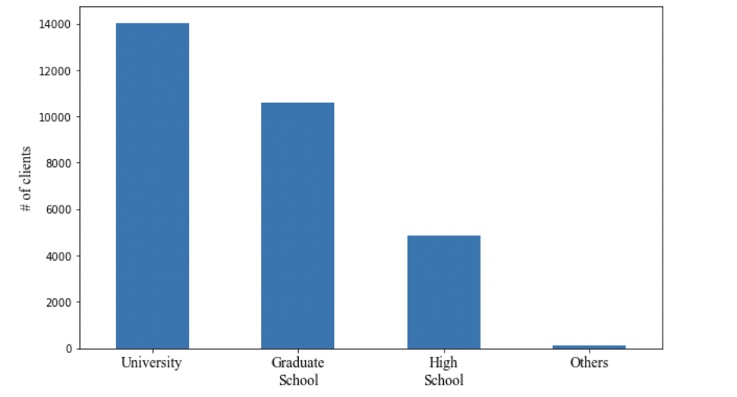
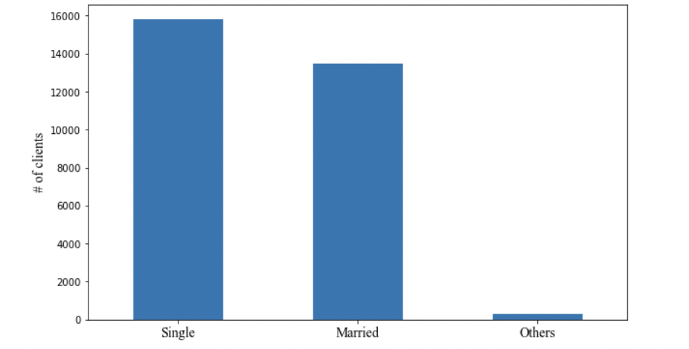
DATA EXPLORATION - part 2
Scatter plots:
used to observe and show relationships/interactions between two variables.
The plots matched with our observations from heatmap.
Histogram plots:
the group the data in bins and is the fastest way to get idea about each attribute in dataset.
It provides us a count of the number of observations in each bin created for visualization.

Slide 8
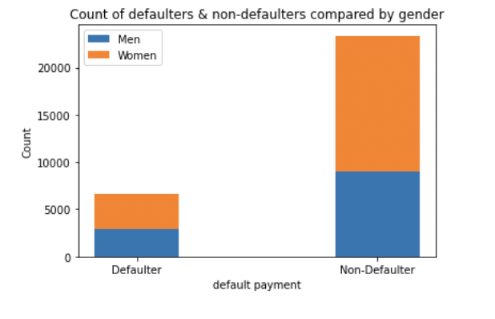
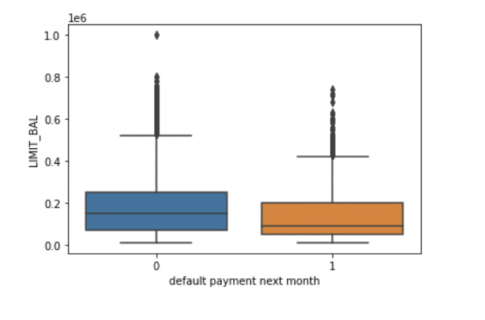
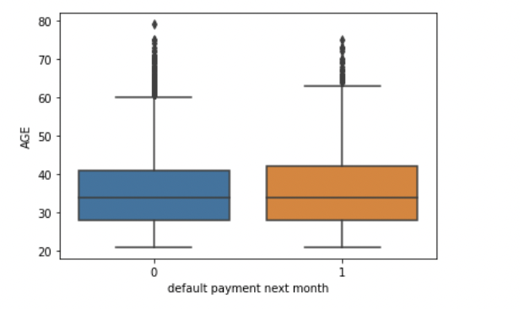
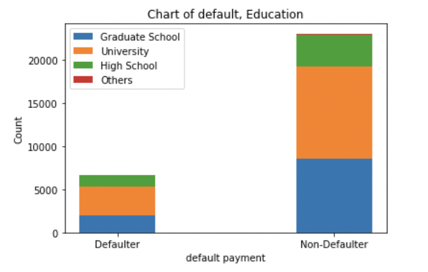
DATA EXPLORATION - part 3
Box plots:
the boxplots for each of the numerical features are plotted in order to have a further look at the distribution and to eventually spot outliers
Stacked bar charts:
each bar is visually divided into sub bars to represent multiple column data at once.
Gives holistic information of all categories of a variable.

Slide 9
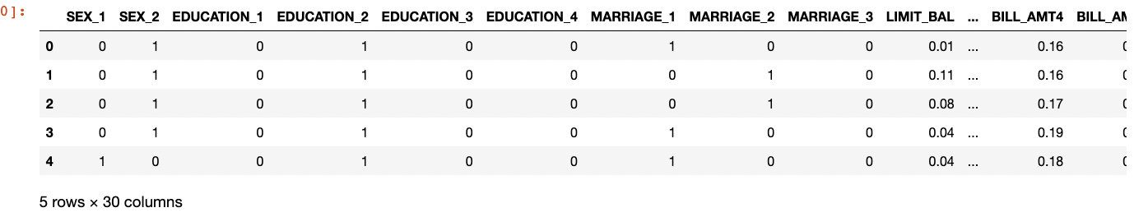
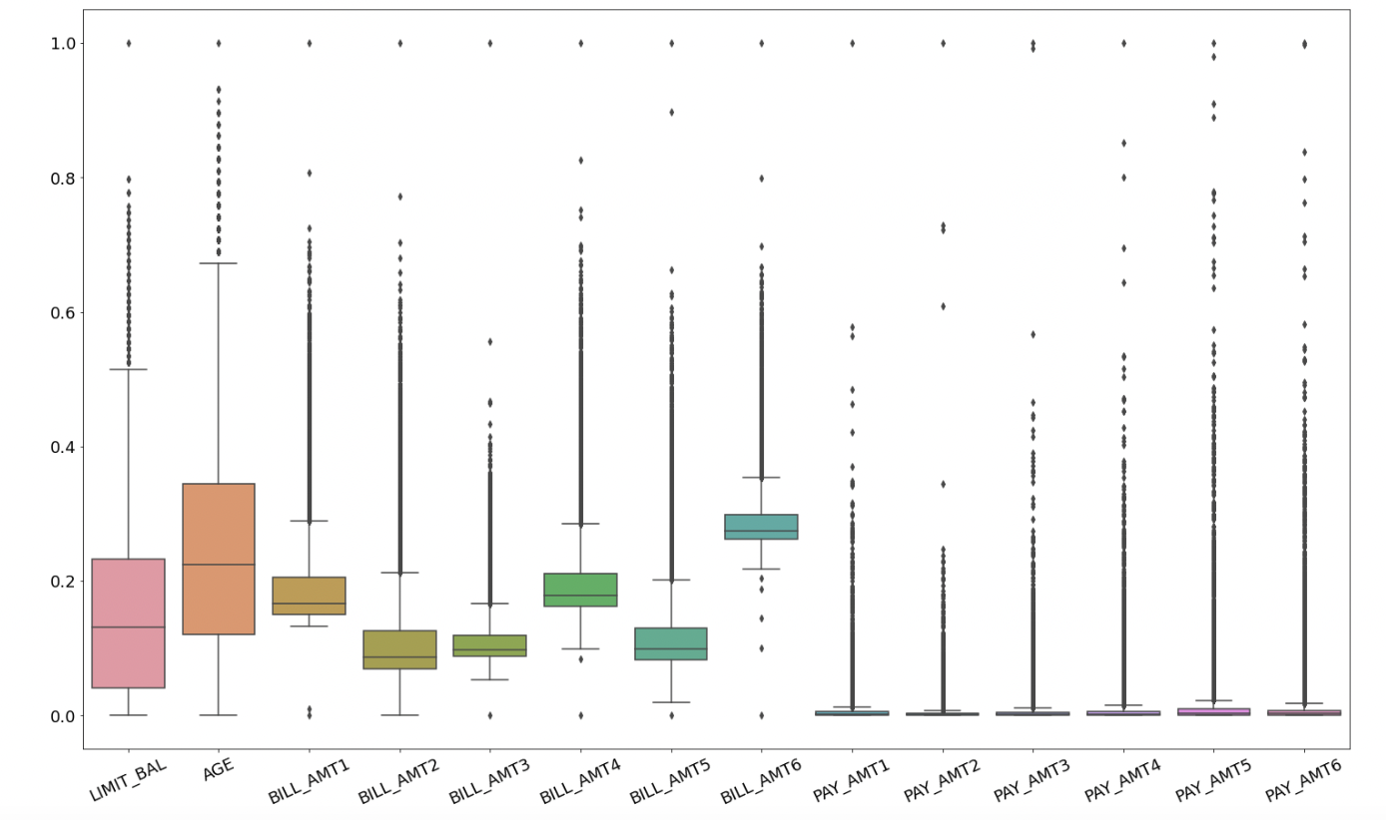
DATA PRE-PROCESSING – part1
One-hot encoding
Categorical variable such as SEX, MARRIAGE and EDUCATION are turned into one-hot variables in order to remove any orders that in this case have no meaning.
Feature Scaling:
MinMaxScaler() has been already applied to all the numerical features.

Slide 10
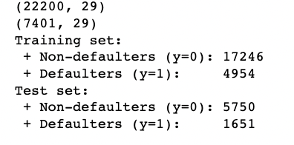
DATA PRE-PROCESSING – part2
Train-Test splitting
The dataset is divided in training set and test set, with the proportion 3:1.
Given the imbalance fashion in the original dataset a stratified sampling strategy has been applied during the split
To maintain that the proportion of defaulters/non-defaulters clients in each of the final sets would approximately be the same as the initial one.

Slide 11

MODEL SELECTION
Logistic Regression
Stochastic Gradient Descent
K-Nearest Neighbour
Support Vector machine
Gaussian Naïve bayes
Decision Trees
Random forest

Slide 12
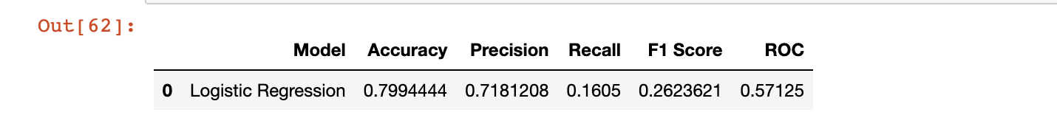
Logistic Regression
In Logistic Regression, we wish to model a dependent variable(Y) in terms of one or more independent variables(X). It is a method for classification.
This algorithm is used for the dependent variable that is Categorical.
Y is modeled using a function that gives output between 0 and 1 for all values of X.
The individual who doesn’t make payment by due date is assigned as 0
The individual who makes payment by the due payment assigned as 1
In Logistic Regression, the Sigmoid (aka Logistic) Function is used

Slide 13
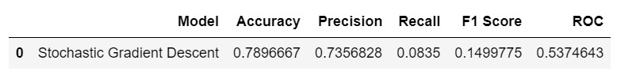
Stochastic Gradient Descent (SGD)
Stochastic Gradient Descent (SGD) is a simple yet very efficient approach to discriminative learning of linear classifiers under convex loss functions such as (linear) Support Vector Machines and Logistic Regression.
It is on of the Gradient Descent Algorithm.
Stochastic Gradient Descent, a few samples are selected randomly instead of the whole data set for each iteration.
The sample is randomly shuffled and selected for performing the iteration.

Slide 14
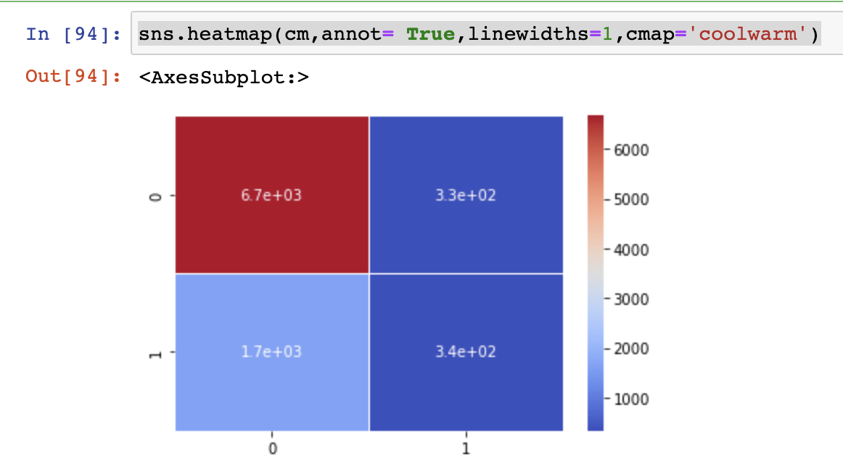
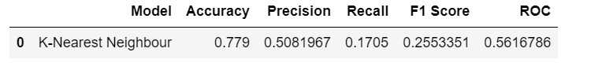
K-Nearest Neighbors(KNN)
KNN can be used for both classification and regression predictive problems. However, it is more widely used in classification problems in the industry.
It captures the idea of similarity (sometimes called distance, proximity, or closeness) with some mathematics we might have learned in our childhood— calculating the distance between points on a graph.
KNN focuses on easy implementation and good performance at the cost of computational time, but in our case the size of the dataset is considerably small so we can apply KNN.

Slide 15
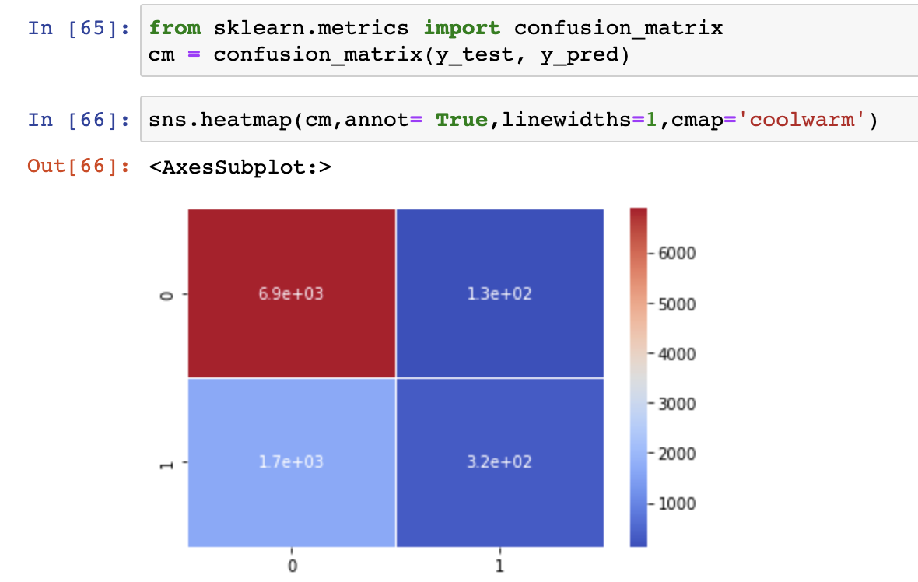
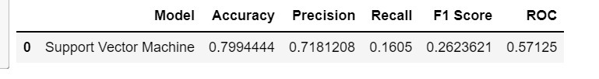
Support Vector Machine(SVM)
SVM or Support Vector Machine is a linear model for classification and regression problems.
It can solve linear and non-linear problems.
The objective of the support vector machine
algorithm is to find a hyperplane in an
N-dimensional space(N the number of features)
that distinctly classifies the data points.
The algorithm creates a line or a hyperplane
which separates the data into classes using different
kernel tricks like = 'linear','rbf' (gaussian).

Slide 16
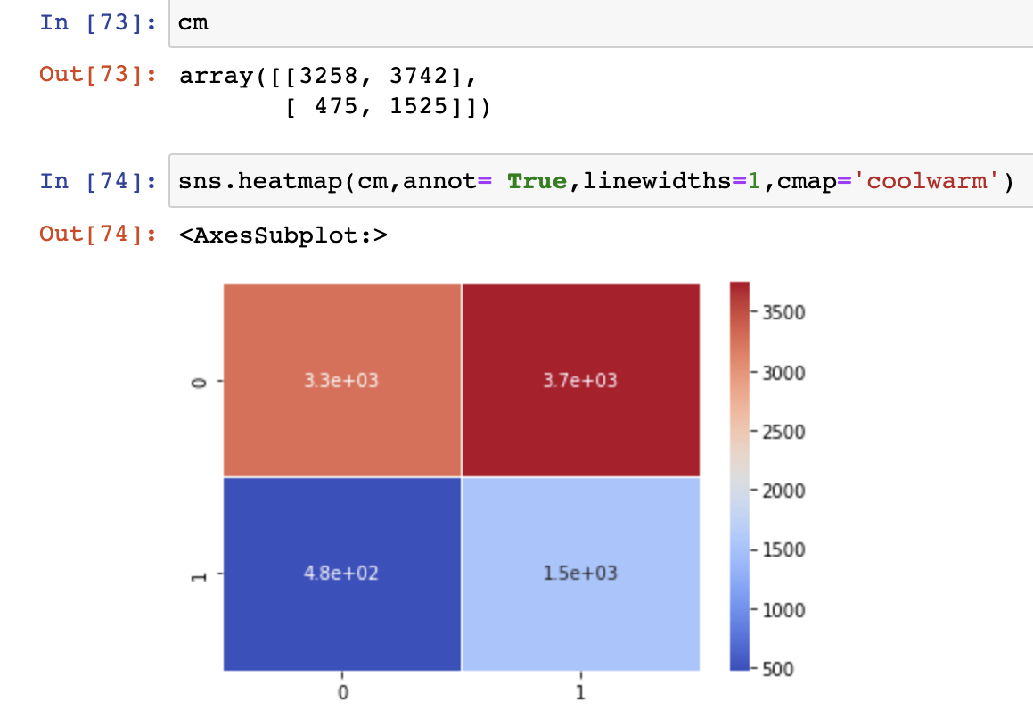
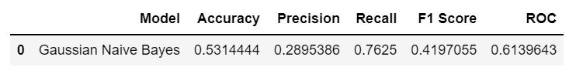
Gaussian Naive Bayes
Gaussian Naive Bayes supports continuous valued features and models each as conforming to a Gaussian (normal) distribution
Other functions can be used to estimate the distribution of the data, but the Gaussian (or Normal distribution) is the easiest to work with because you only need to estimate the mean and the standard deviation from your training data

Slide 17
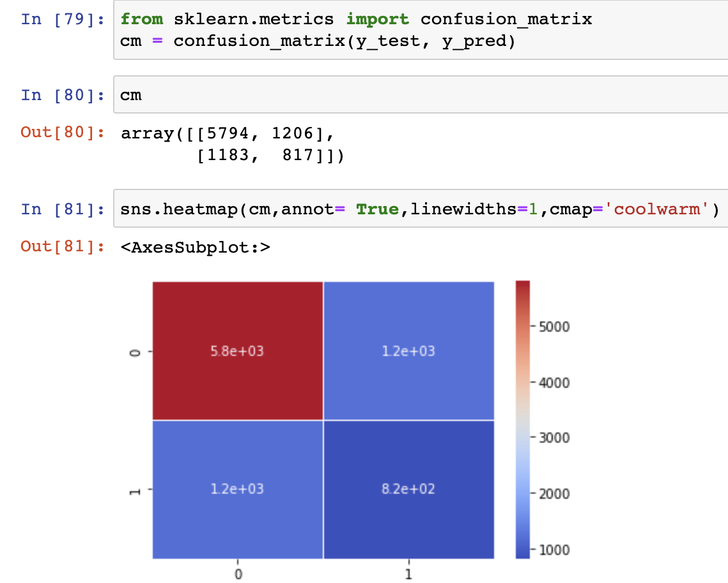
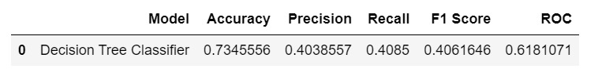
Decision Tree Classification
Decision tree builds classification or regression models in the form of a tree structure.
The idea of a decision tree is to divide the data set into smaller data sets based on the descriptive features
until you reach a small enough set that contains data points that fall under one label.

Slide 18
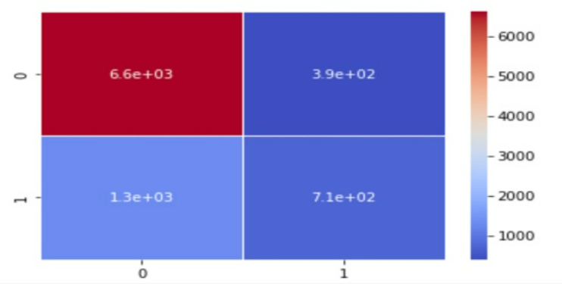
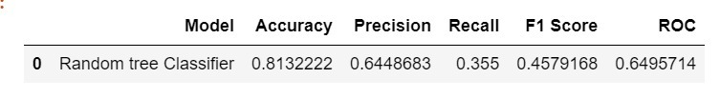
Random Forest
Random Forest is a supervised learning algorithm.
It creates a forest and makes it random. The "forest“ it builds, is an ensemble of Decision Trees.
Following are the steps used to execute Random forest
Step1:- Pick at random K data points from the training set
Step2:- Build the Decision tree associated to these K data points
Step3:- Choose the Number of trees(n) you want to build and repeat STEP1 and STEP2
Step4:- For a new data points make each one of your 'n' trees predict the category to which the data point belongs and assign the new data point to the category that wins the majority vote

Slide 19

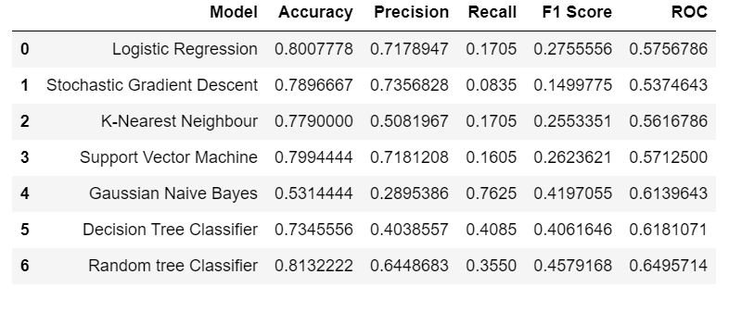
MODEL COMPARISON

Slide 20
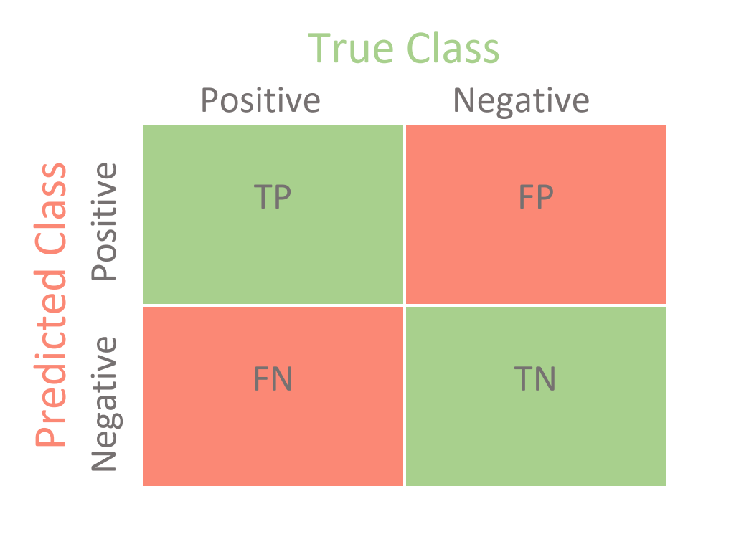
MODEL EVALUATION
We will evaluate the performance of the model on some test data. For this, we use the Confusion Matrix
The accuracy of the model : - ( TP + TN ) / Total
Here, TP stands for True Positive which are the cases in which we predicted YES and the actual value was TRUE.
TN stands for True Negative which are the cases in which we predicted NO and the actual value was FALSE.
FP stands for False Positive which are the cases which we predicted YES and the actual value was FALSE.
FN stands for False Negative which are the cases which we predicted NO and the actual value was TRUE.

Slide 21
CONCLUSION
We found that using the models -> Random Forest classifier and Logistic Regression are better.
The strongest predictors of default are the PAY_X (ie the repayment status in previous months), the LIMIT_BAL & the PAY_AMTX (amount paid in previous months).
Demographics: we see that being Female, More educated, Single and between 30-40years old means a customer is more likely to make payments on time.

Slide 22


